Slide 1


Climate Change Impacts
Adapting to Climate Change
Global Climate Change EART21202 – Week 8
Dr Thomas Bannan
Thomas.Bannan@Manchester.ac.uk

Slide 2


Global Climate Change - 2026
Week 1 – Introduction to climate change and its impacts (5th Feb)
Week 2 – Natural climate variability (12th Feb)
Week 3 – Radiation Law/Greenhouse Effect/Radiative forcing/feedbacks (19th Feb)
Week 4 – Anthropogenic impacts (26th Feb)
Week 5 – The Evidence Base for Climate Change (5th March)
Week 6 – Mid Unit Test (10th March)
Week 7 – Climate Models (19th March)
Week 8 – Climate Change Adaptation (26th March)
Week 9 – Effects of Climate Change: Case Studies (23rd April)
Week 10 – Climate Change Mitigation (30th April)
Week 11 – Revision Lecture (7th May)
Comments/Questions

Slide 3

Today’s session
  Part 1: Key points on climate change impacts (20 mins)
  Part 2: Climate change adaptations (30 mins)
  Part 3: Q/A and Break (10 mins)
  Part 4: Workshop (50 mins)

Slide 4
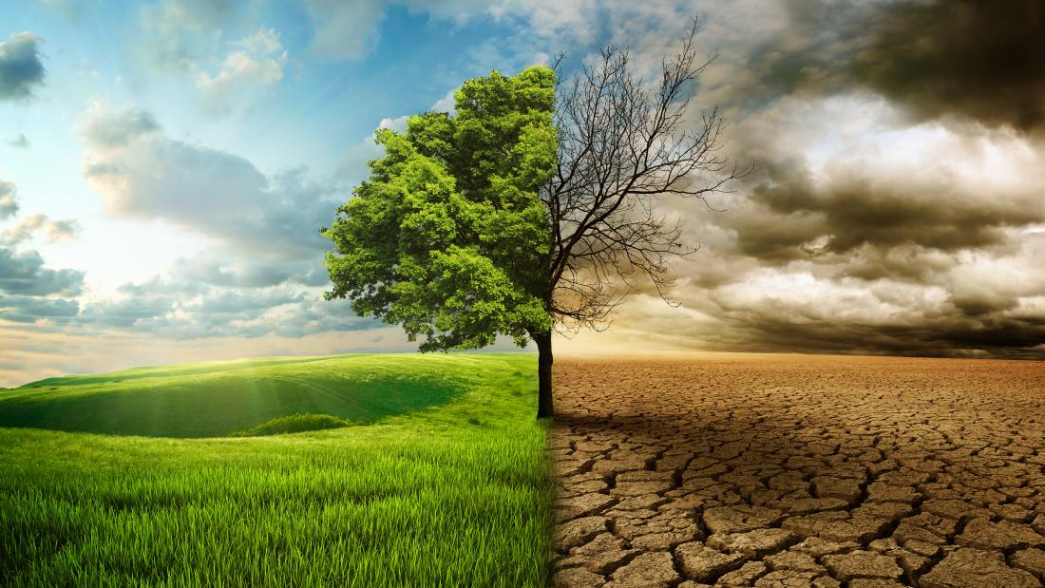
Intended Learning Outcomes
By the end of the week you will be able to:
Provide examples of climate-change driven impacts and explain how these vary across the globe.
Describe the difference between adaptation and mitigation.
Discuss differences in information needed for adaptation and mitigation planning.
Outline different climate adaptation strategies and discuss their suitability in different regions.

Slide 5

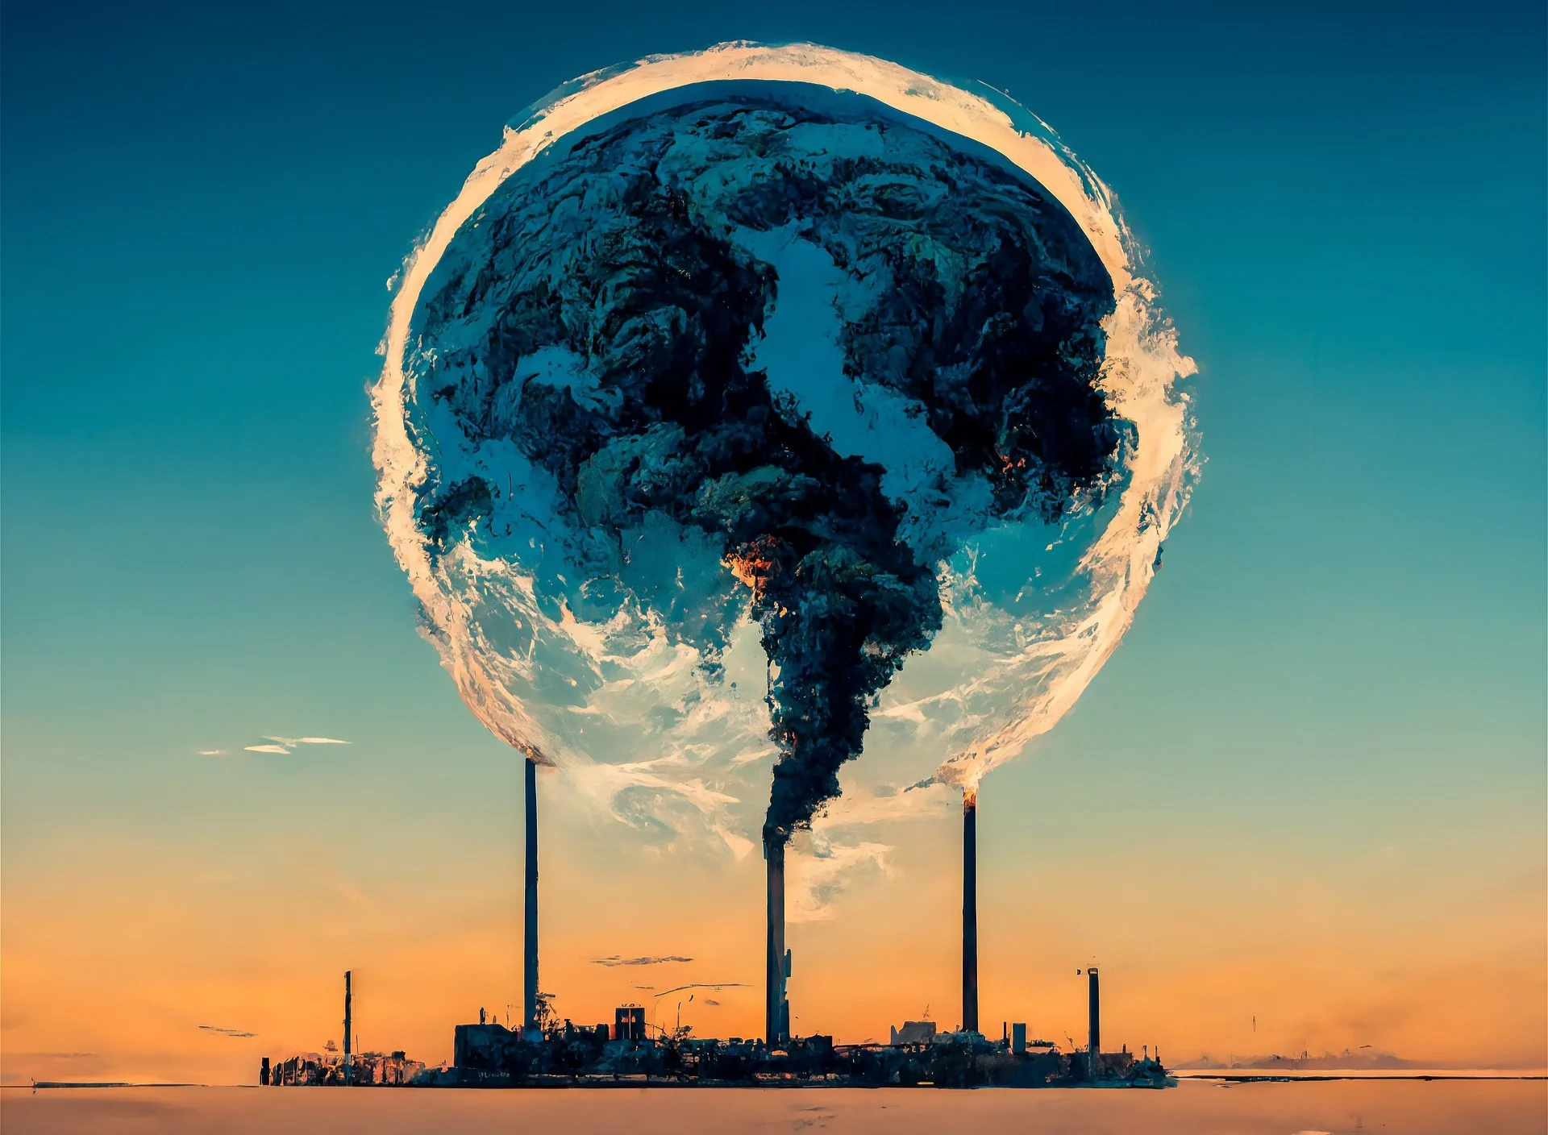
Climate Change
Climate change is one of the most complex issues facing us today.
We have so far focused on the environmental impact
It involves many dimensions – science, economics, society, politics, and moral and ethical questions – and is a global problem, felt on local scales
Carbon dioxide has a lifetime of hundreds of years, so the planet (especially the ocean) takes a while to respond to warming.
So even if we stopped emitting all greenhouse gases today, global warming and climate change will continue to affect future generations.
In this way, humanity is “committed” to some level of climate change.

Slide 6
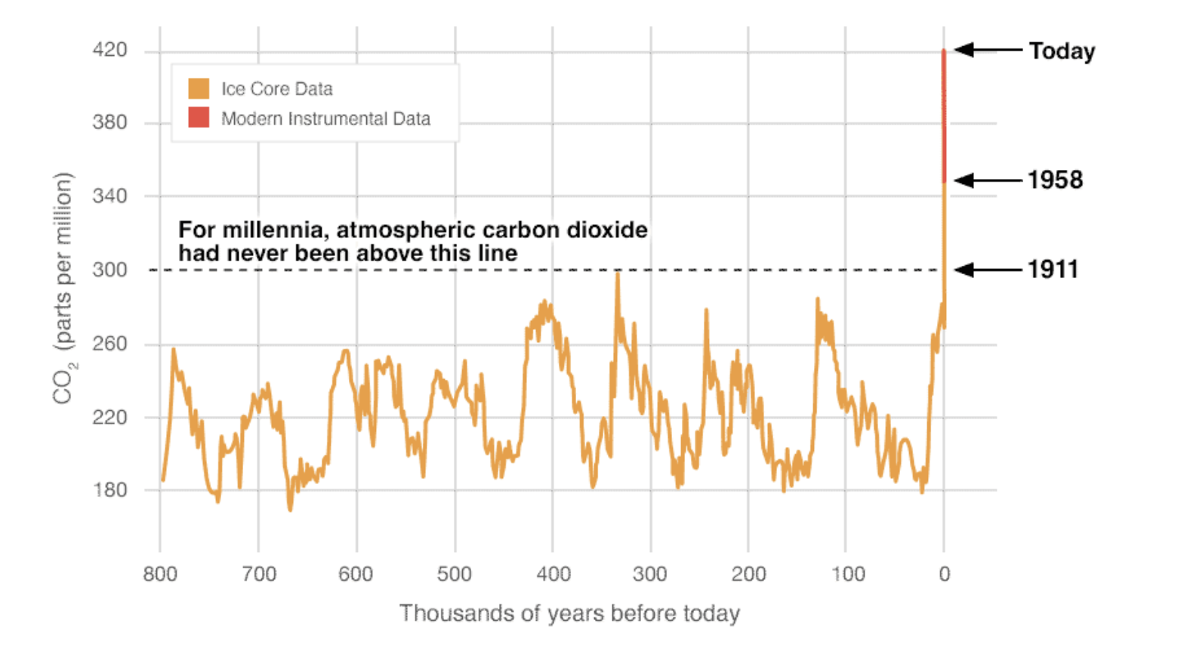
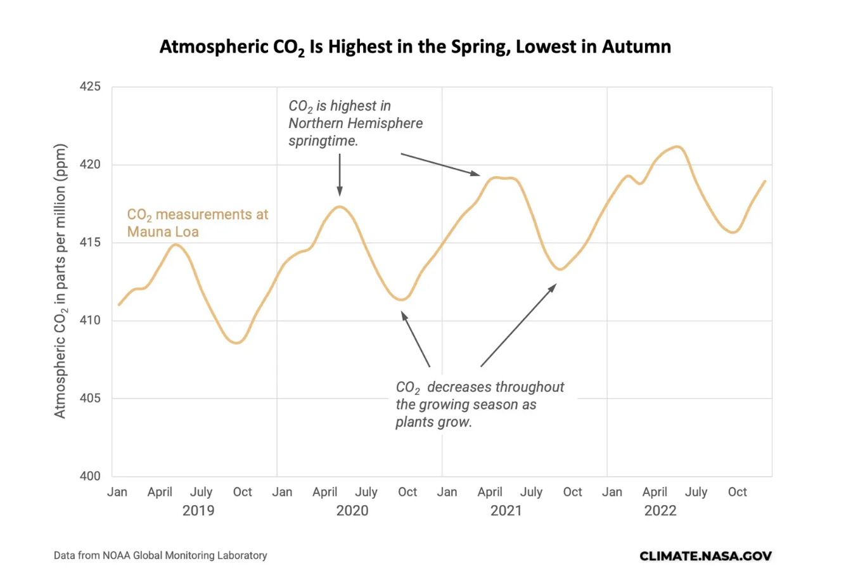
How much climate change?
That will be determined by how our emissions continue and exactly how our climate responds to those emissions.
Despite increasing awareness of climate change, our emissions of greenhouse gases continue to rise
In 2013, the daily level of carbon dioxide in the atmosphere surpassed 400 parts per million for the first time in human history.

Slide 7
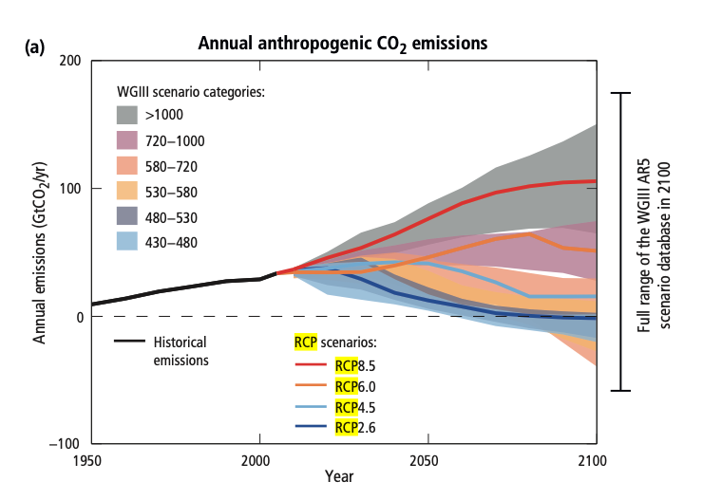
Representative Concentration Pathways
Anthropogenic GHG emissions are mainly driven by population size, economic activity, lifestyle, energy use, land use patterns, technology and climate policy.
The RCPs include a stringent mitigation scenario (RCP2.6)
two intermediate scenarios (RCP4.5 and RCP6.0)
very high GHG emissions (RCP8.5).
Scenarios without additional efforts to constrain emissions (’baseline scenarios’) lead to pathways ranging between RCP6.0 and RCP8.5.
RCP2.6 is representative of a scenario that aims to keep global warming likely below 2°C above pre-industrial temperatures.

Slide 8
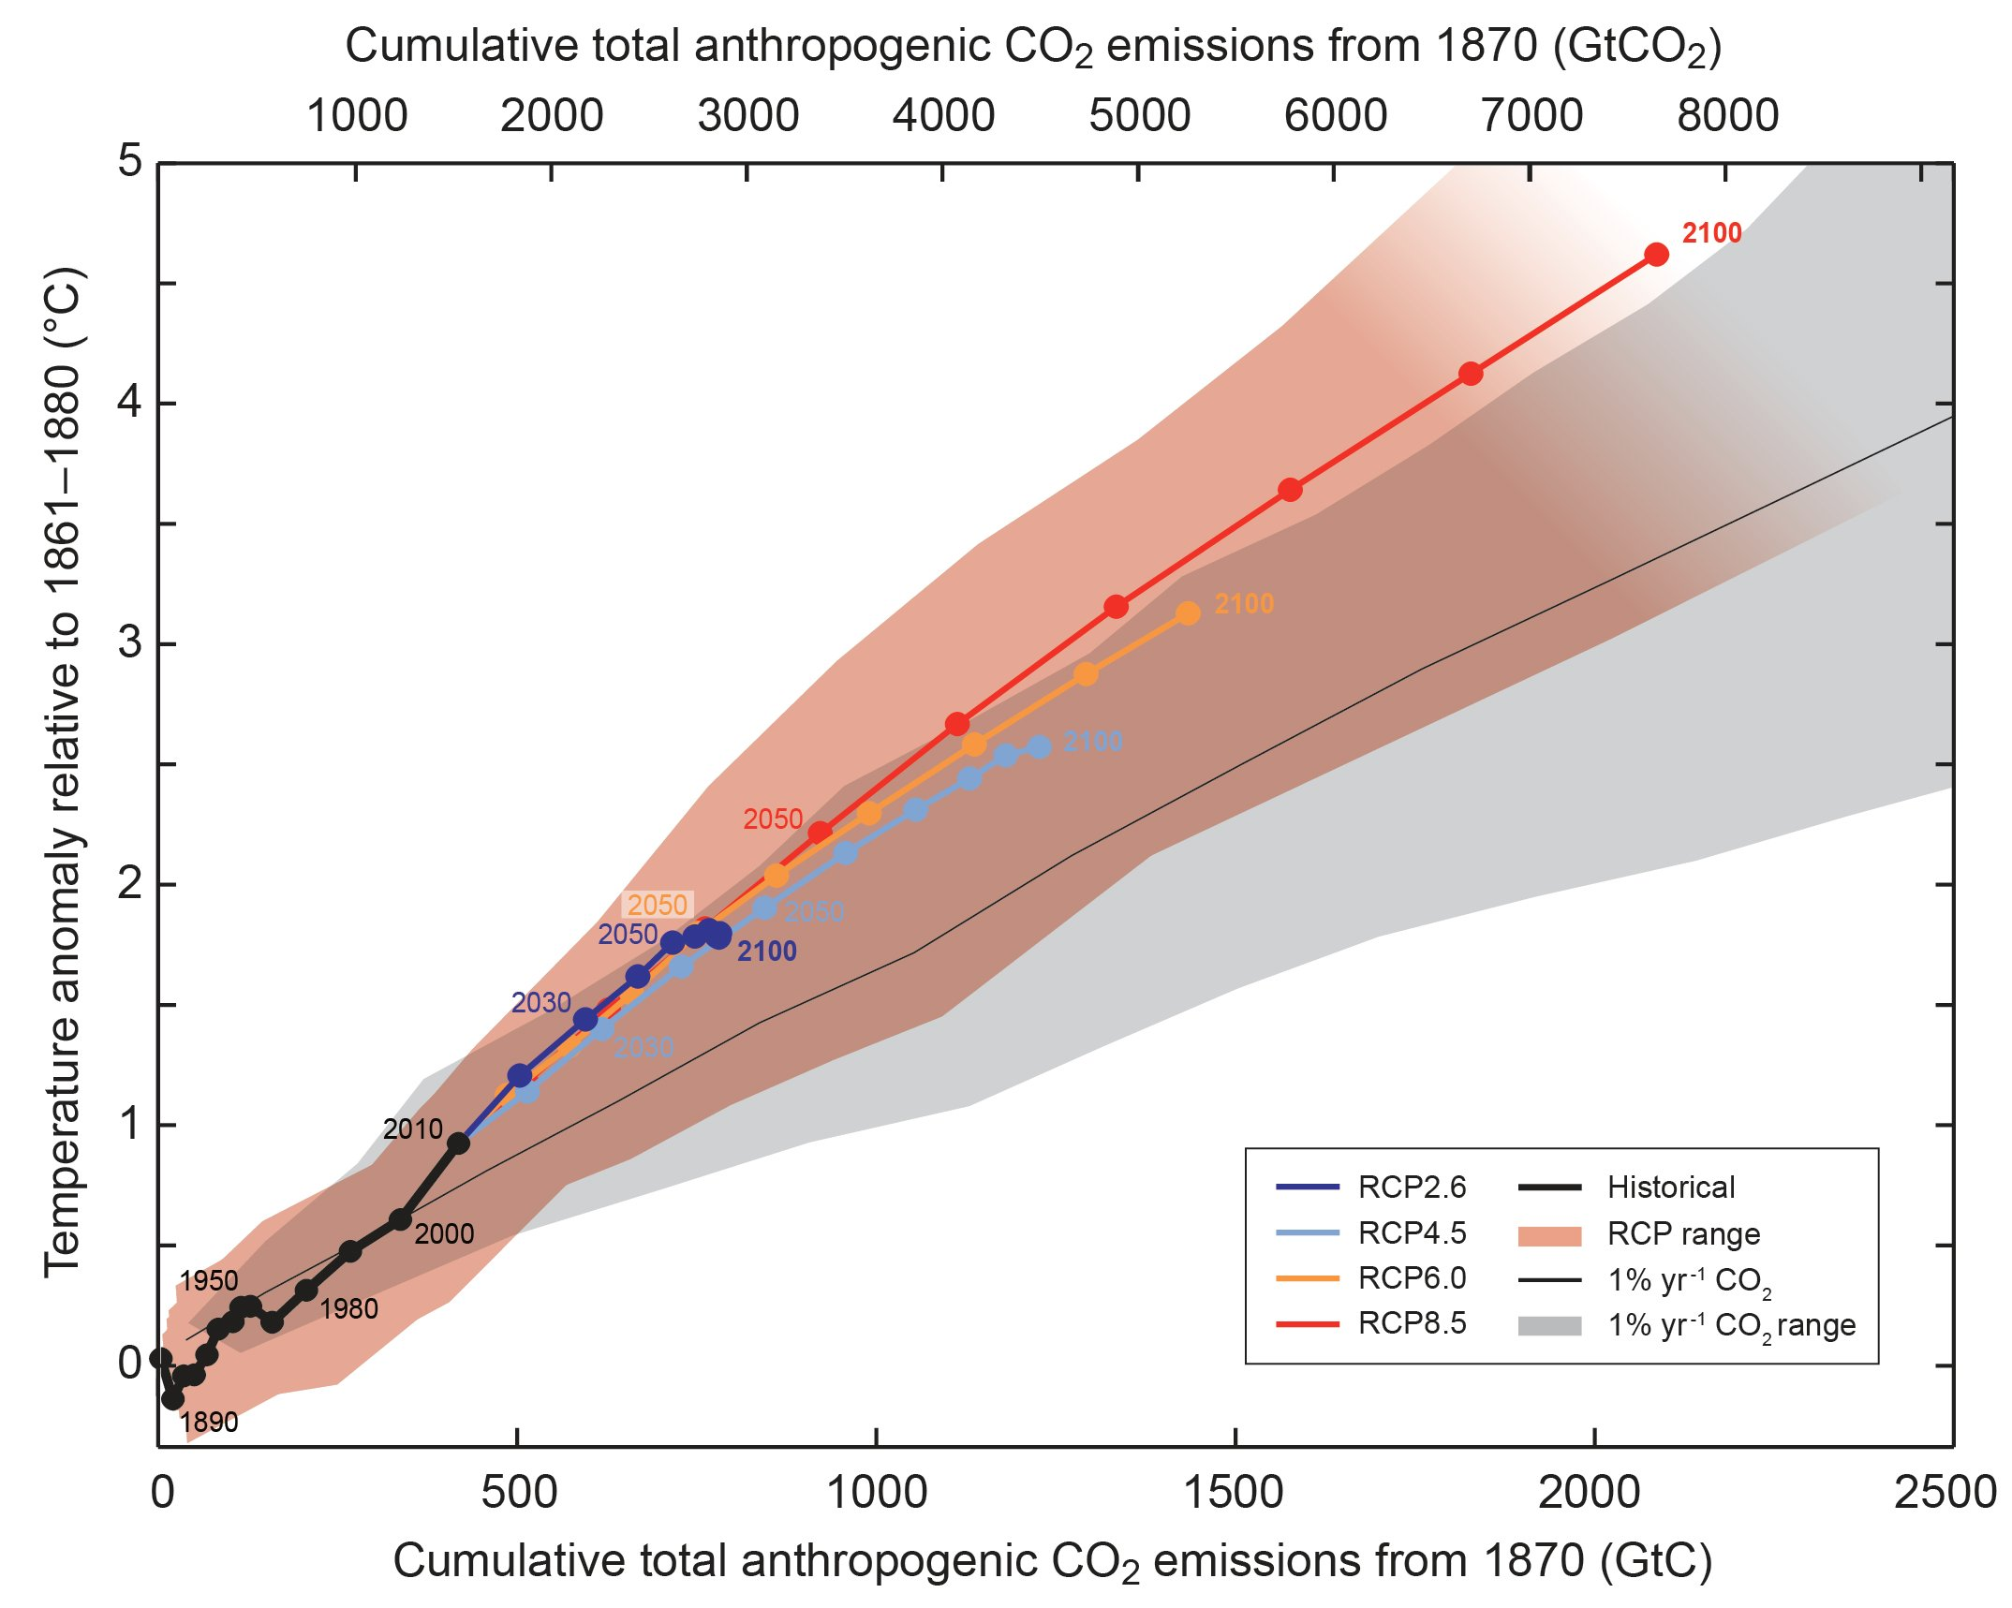
Climate Sensitivity
Good for long term change
Less helpful to steady increases
How do we calculate long term climate change from GHG emissions?
adapted from Figure 2.3, AR5 synthesis report

Slide 9
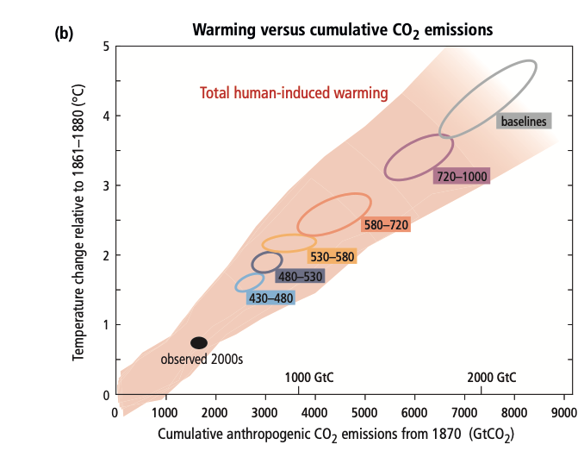
Climate Sensitivity

Slide 10
Climate Sensitivity
How do we calculate long term climate change from GHG emissions?
Every 1000 GtC → 1.5 – 2.5°C
Approximate ‘budget’ to limit warming to 2°C
~20 GtC emitted each year
500 GtC already emitted up to today.
NOTE: 1 GtC = 3.66 GtCO₂
adapted from Figure 2.3, AR5 synthesis report

Slide 11
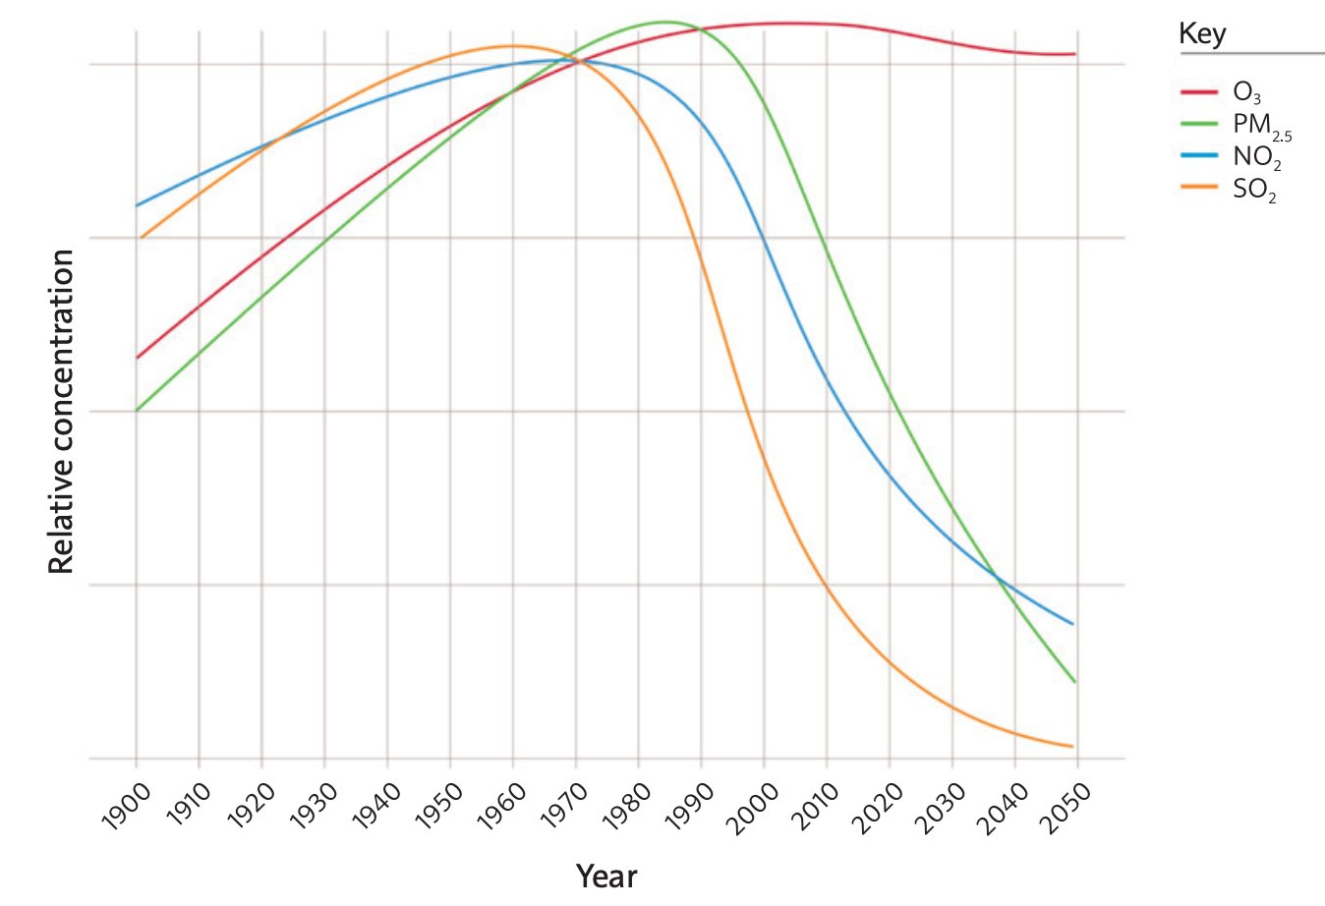
Climate Sensitivity
How do we calculate long term climate change from GHG emissions?
adapted from Figure 2.3, AR5 synthesis report

Slide 12
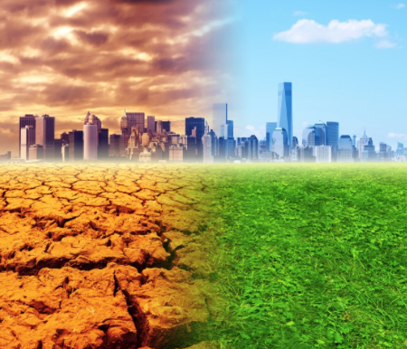
What impact will this have?
Increase Earth's average temperature
Influence the patterns and amounts of precipitation
Reduce ice and snow cover, as well as permafrost
Raise sea level
Increase the acidity of the oceans
Increase the frequency, intensity of extreme events
Shift ecosystem characteristics
Increase threats to human health
What will this depend on?
Increase in greenhouse gas concentrations
Other Anthropogenic radiative forcing effects
Natural influences on climate
Mitigations
Models of the climate system to better understand these issues and project future climate changes

Slide 13
What impact will this have?
Increase Earth's average temperature
Influence the patterns and amounts of precipitation
Reduce ice and snow cover, as well as permafrost
Raise sea level
Increase the acidity of the oceans
Increase the frequency, intensity of extreme events
Shift ecosystem characteristics
Increase threats to human health
What will this depend on?
Increase in greenhouse gas concentrations (weeks 1-5)
Other Anthropogenic radiative forcing effects (weeks 4)
Natural influences on climate (week 2)
Mitigations (week 9)
Models of the climate system to better understand these issues and project future climate changes (week 7).

Slide 14
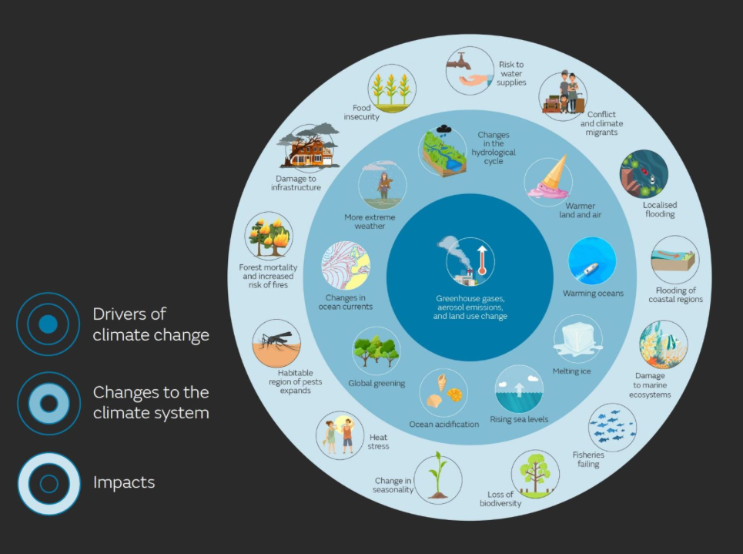

Slide 15
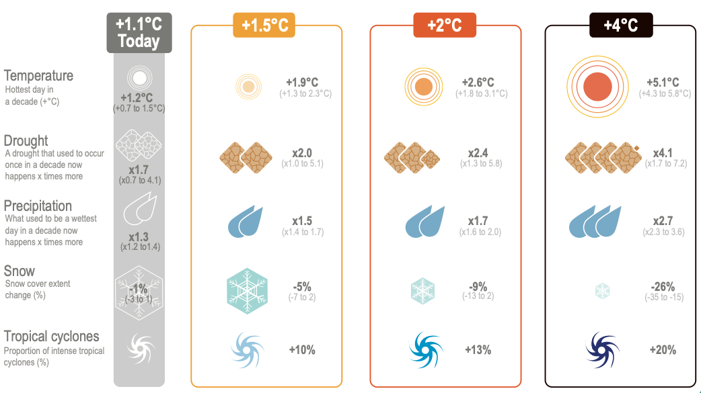
What impact will this have?

Slide 16
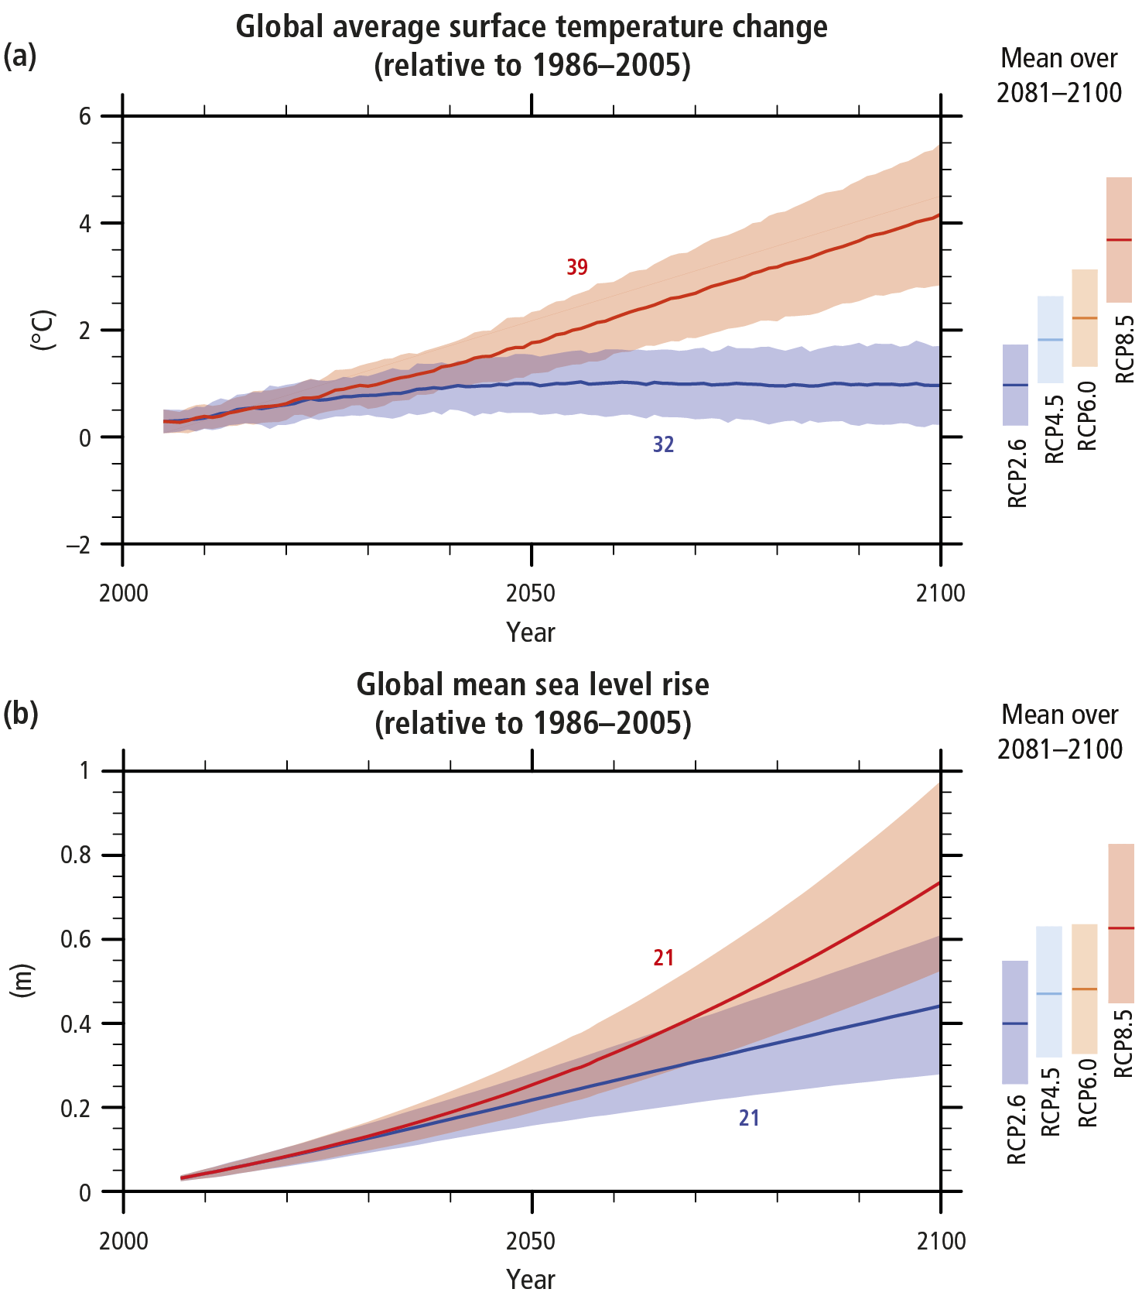
Projections of Future Change: Temperature
Low future emissions
High future emissions
Figure SPM.6, AR5 synthesis report

Slide 17
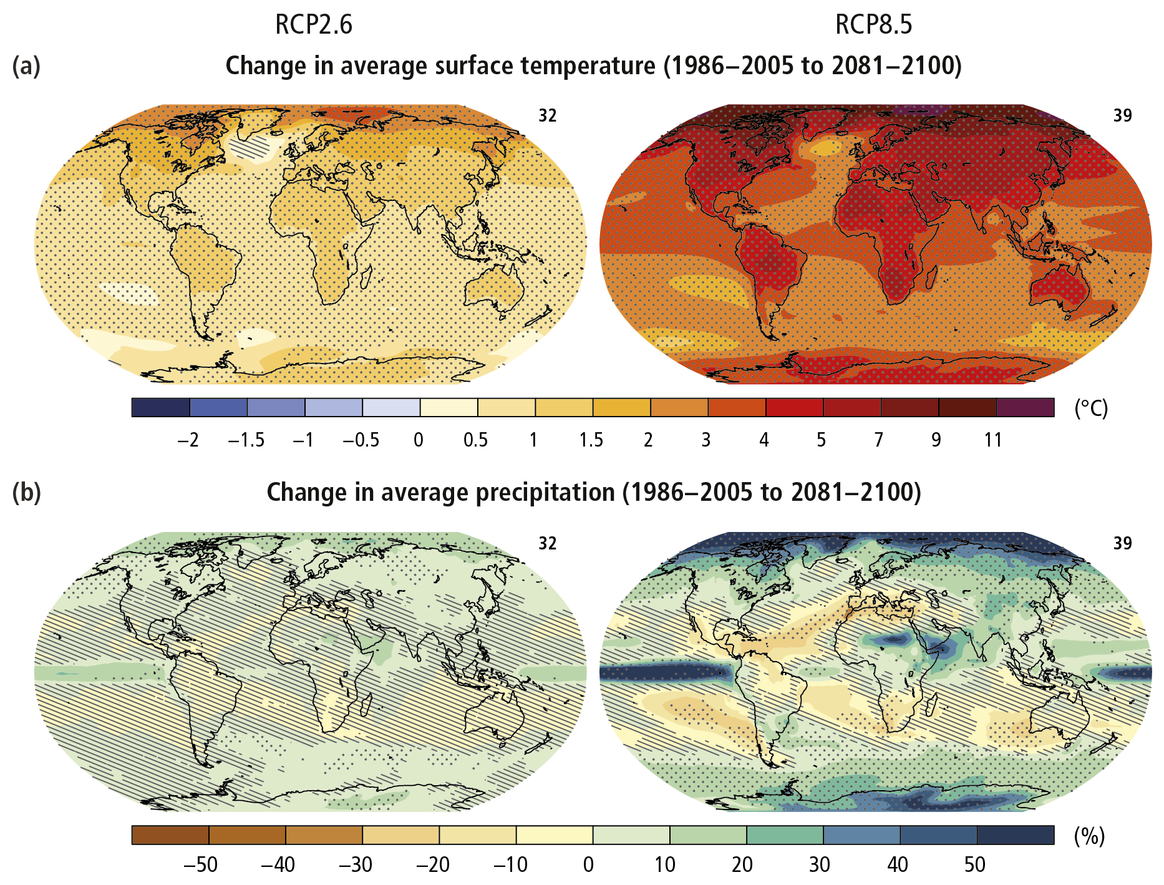
Projections of Future Change: Temperature
Warming will continue to be different around the globe, being stronger over the land compared to over the ocean and strongest in the Arctic.
Except under the most aggressive mitigation scenario studied, global average temperature is expected to warm at least twice as much in the next 100 years as it has during the last 100 years.
Ground-level air temperatures are expected to continue to warm more rapidly over land than oceans.
Each region is unique and affected by climate change in its own way.
Low emission scenario
High emission scenario
Figure SPM.7, 2.2, AR5 synthesis report

Slide 18
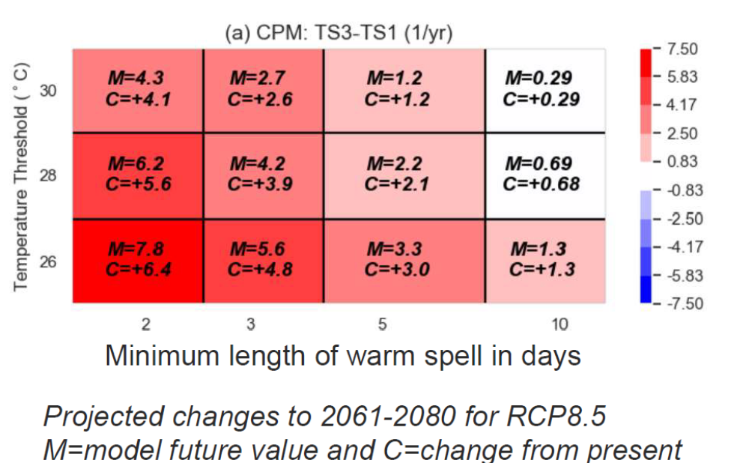
Projections of Future Change: Temperature, UK
Hot spells become more frequent
Exceeding 30ºC for ≥ 2 days rises from typically once every 5 years now, to about four times every year by 2070s.

Slide 19
Projections of Future Change: Temperature, UK
Hot spells become more frequent
Exceeding 30ºC for >5 days will typically happen at least once every year, while they very rarely happen now.

Slide 20
Projections of Future Change: Precipitation
These changes are less certain than the changes associated with temperature.
Some regions may have less precipitation, some may have more precipitation, and some may have little or no change.
The amount of rain falling in heavy precipitation events is likely to increase in most regions, this will be particularly pronounced in tropical and high-latitude regions, which are also expected to experience overall increases in precipitation.
The amount of precipitation falling in tropical storms is also likely to increase.
Low emission scenario
High emission scenario
Figure SPM.7, 2.2, AR5 synthesis report

Slide 21
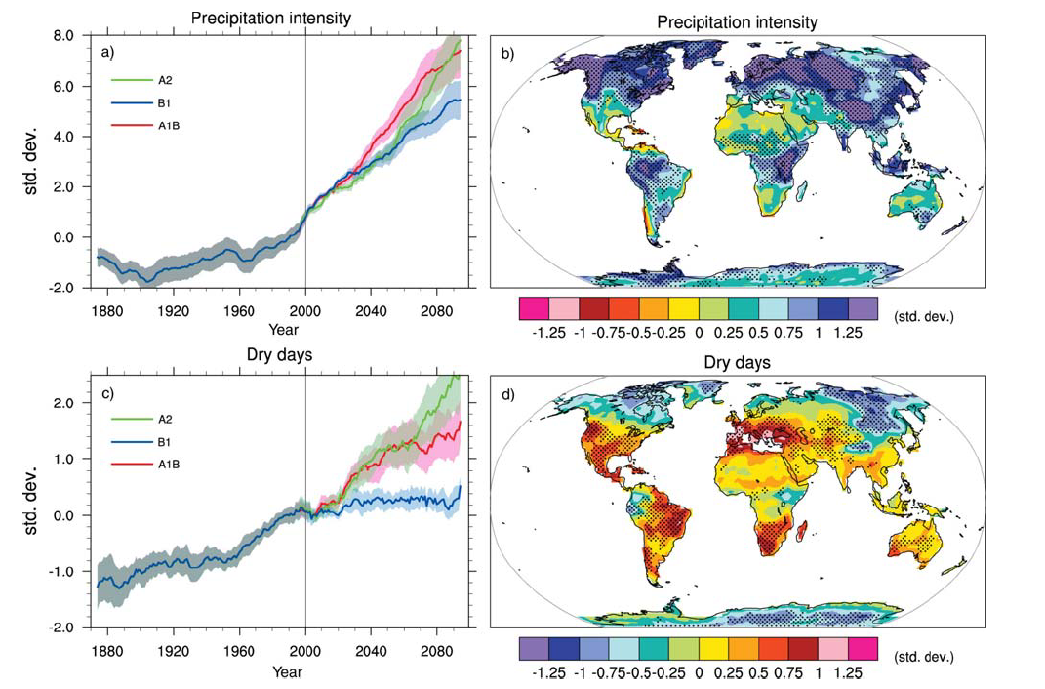
Projections of Future Change: Precipitation
Figure 10.18, AR5 full report

Slide 22
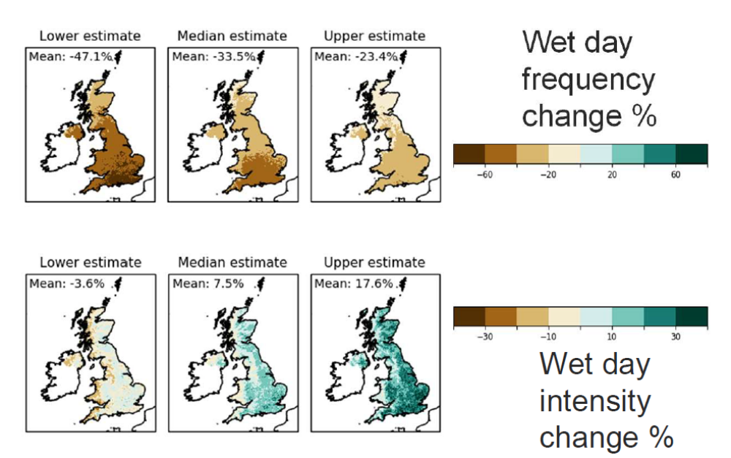
Projections of Future Change: Precipitation, UK
UK ‘local’ climate projections: summer rainfall
Summer rainfall is less frequent but more intense

Slide 23
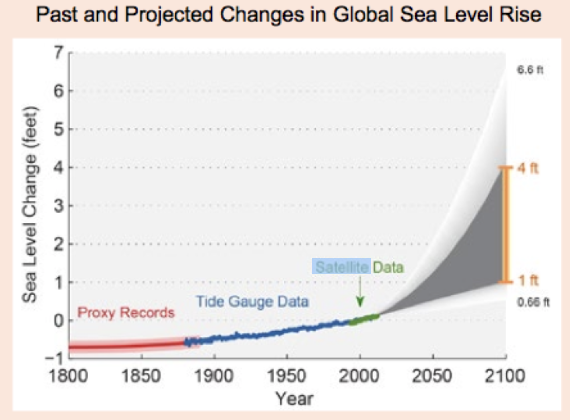
Projections of Future Change: Sea Level
Warming temperatures contribute to sea level rise by:
  expanding ocean water (well understood)
  melting mountain glaciers and ice caps (well understood)
  the Greenland and Antarctic ice sheets to melt or flow into the ocean (less well understood, account for 1.2 to 8 inches of sea level rise)
Since 1870, global sea level has risen by about 7.5 inches
Global sea level for the next century is expected to rise at a greater rate than during the past 50 years.
Studies project global sea level to rise by another 1 to 4 feet by 2100
Large uncertainty about how glaciers and ice sheets will react to climate change
Regional and local factors will influence future relative sea level rise for specific coastlines around the world.
Relative sea level rise also depends on local changes in currents, winds, salinity, and water temperatures, as well as proximity to thinning ice sheets.

Slide 24
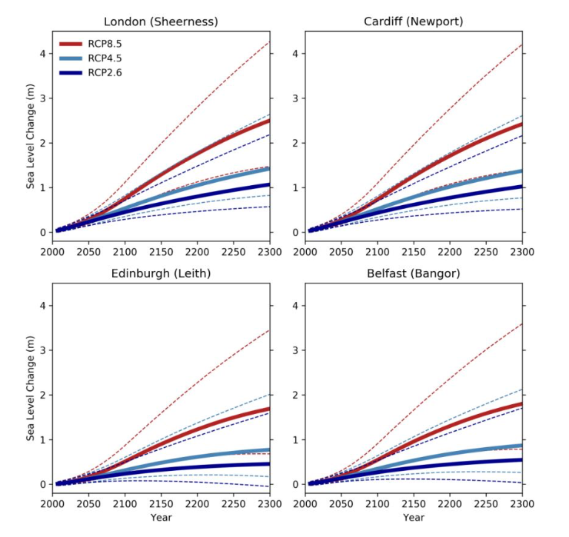
Projections of Future Change: Sea Level
Sea level rise is the dominant driver of increased coastal flood risk, both historically and in future projections of climate change.
Individual UK flood events are usually associated with extreme weather conditions, particularly the generation of storm surges, which can be compounded by the action of wind-generated surface waves.
However, projections of changes in frequency and severity of future coastal extreme water levels are dominated by the long-term increase in coastal water levels associated with climate change
One of the main outcomes of the research was the demonstration that UK sea levels will continue to rise well beyond 2100 under all future emissions scenarios

Slide 25
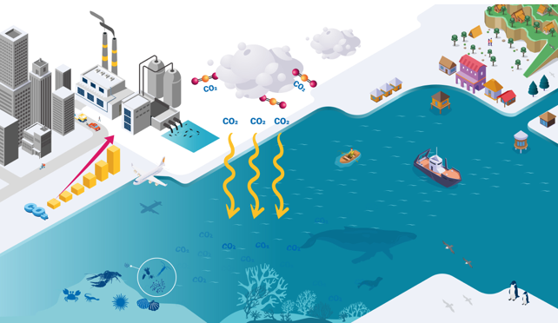
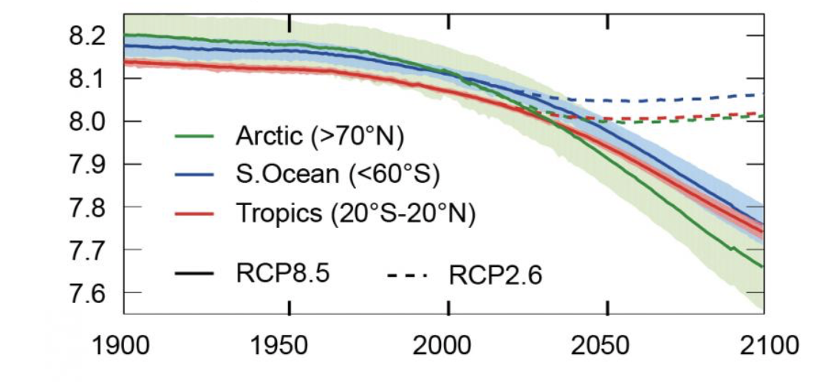
Projections of Future Change: Ocean Acidification
Ocean acidification is a consequence of increasing carbon dioxide (CO₂) emissions
When CO₂ dissolves in seawater, it forms carbonic acid (H₂CO₃)
Acidity plays a key role in many biological mechanisms, including calcification.
Calcium carbonate (CaCO₃) is crucial for organisms which need calcium to develop, build and maintain their shells and skeletons, such as certain types of plankton, oysters, crabs, sea urchins, shrimps and lobsters.
Ocean acidification makes it harder for them to maintain these calcified structures. This can cause disruptions within food chains.
Ocean acidification can also impact the ability of coral reefs to recover from warming and other stressors, by making it harder for corals to build their calcium-based skeletons.
If CO₂ concentrations continue to rise at their current rate, the combination of climate warming and ocean acidification could slow coral growth by nearly 50% by 2050.
Ocean acidification impacts both small coastal communities and big industries. By harming aquaculture and tourism, communities that rely on the ocean as a source of food and income will be particularly affected.

Slide 26
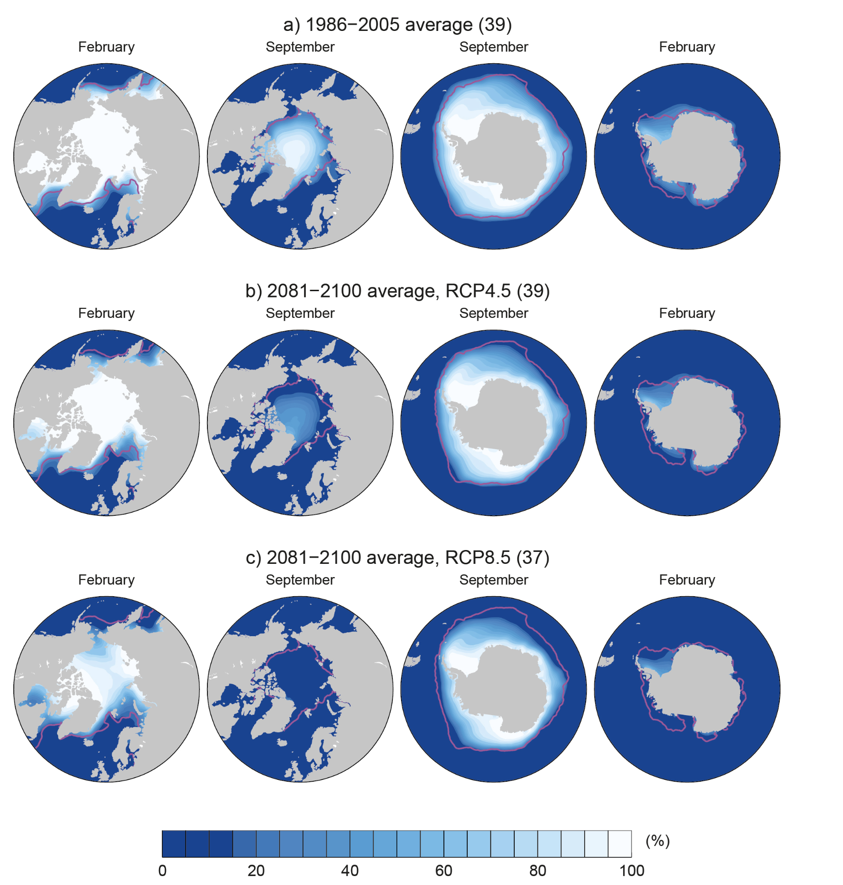
Projections of Future Change: Sea Ice
Arctic sea ice is already declining.
The area of snow cover in the Northern Hemisphere has decreased since about 1970.
Permafrost temperatures in Alaska and much of the Arctic have increased over the last century.
It is expected that sea ice will continue to decline, glaciers will continue to shrink, snow cover will continue to decrease, and permafrost will continue to thaw.
The coastal sections of the Greenland and Antarctic ice sheets are expected to continue to melt or slide into the ocean.
If the rate of this ice melting increases in the 21st century, the ice sheets could add significantly to global sea level rise.
Glaciers are expected to continue to decrease in size. The rate of melting is expected to continue to increase, which will contribute to sea level rise.
Low emission scenario
High emission scenario

Slide 27
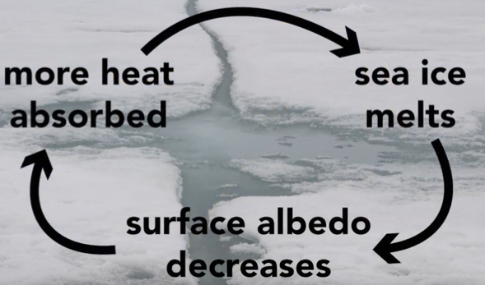
Projections of Future Change: Sea Ice
Low emission scenario
High emission scenario

Slide 28
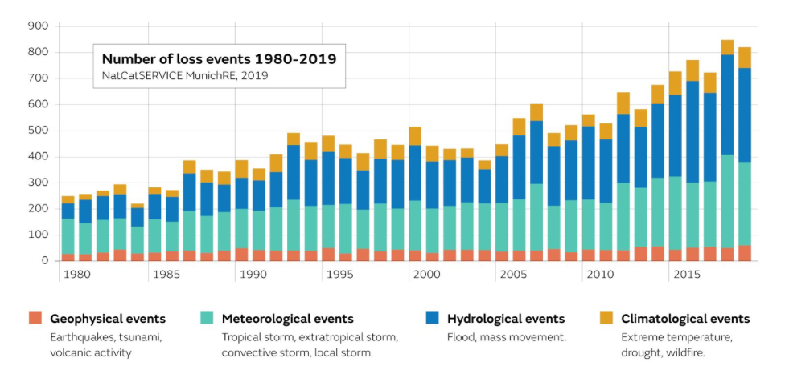
Projections of Future Change: Extreme Events

Slide 29
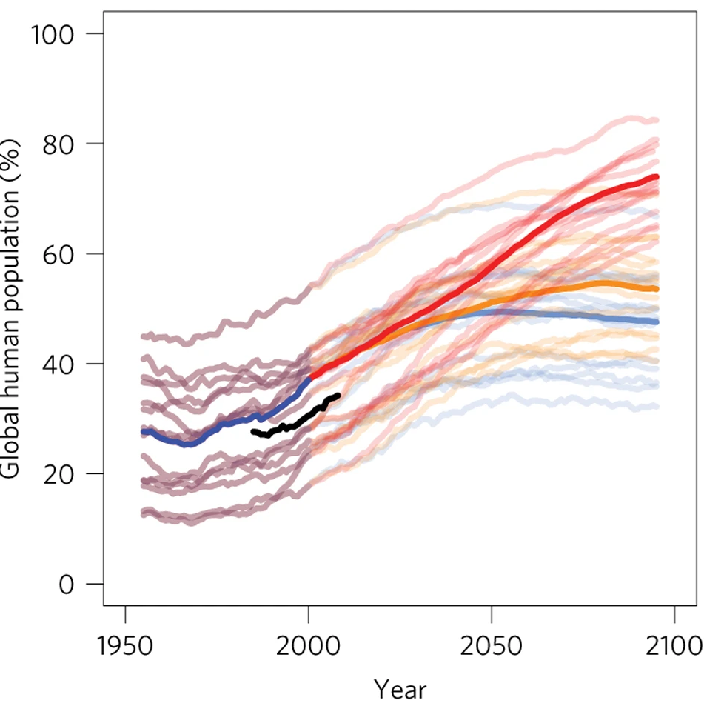
Climate Change Impacts – Health
Increased heat-related mortality, decreased cold-related mortality
Altered distribution of water-borne illnesses and disease vectors
Vulnerable populations: Higher risks for those lacking essential infrastructure, services, and quality housing.
Projected risks:
More heatwaves & wildfires → injury, disease, death
Increased under-nutrition from lower food production in poor regions
Lost work capacity & lower productivity in vulnerable populations.
Increased food- and water-borne diseases
Increased vector-borne diseases
Most effective interventions:
Improve public health measures (clean water, sanitation, vaccination).
Enhance disaster preparedness & health care access.
Reducing vulnerability through:
  Improved housing & infrastructure
  Multi-level risk governance & policy alignment
  Strengthened local government & community adaptation
% of human population exposed to deadly heat for at least 20 days a year
Mora et al. (Nature Climate Change, 2017)

Slide 30
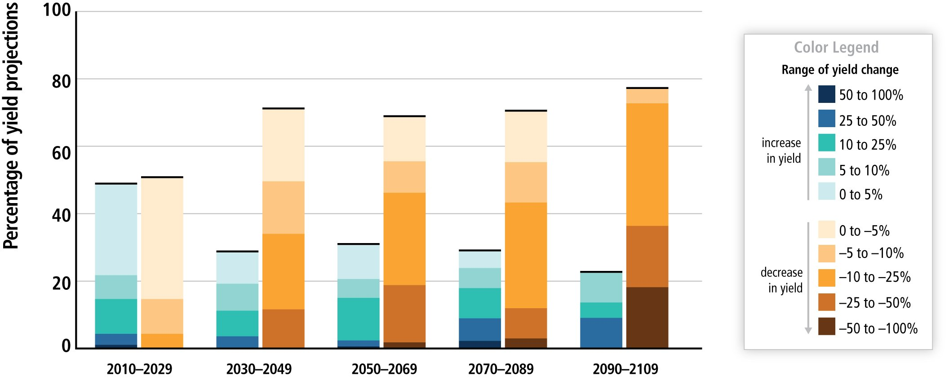
Climate Change Impacts
Health
  Weather-related mortality
  Infectious and respiratory illnesses
Agriculture
  Crop yields
  Irrigation demands
Overall projected changes in crop yields for different regions, emissions scenarios and adaptation approaches.
Major crops (wheat, rice, maize): Likely yield declines with >2°C warming
Future risks: After 2050, more severe impacts expected, with increased yield variability.
Food security: Climate change affects access, and price stability
Severe warming (~4°C+): High risk to global food security, especially in low-latitude regions.
Figure SPM.9, 2.7, AR5 synthesis report

Slide 31
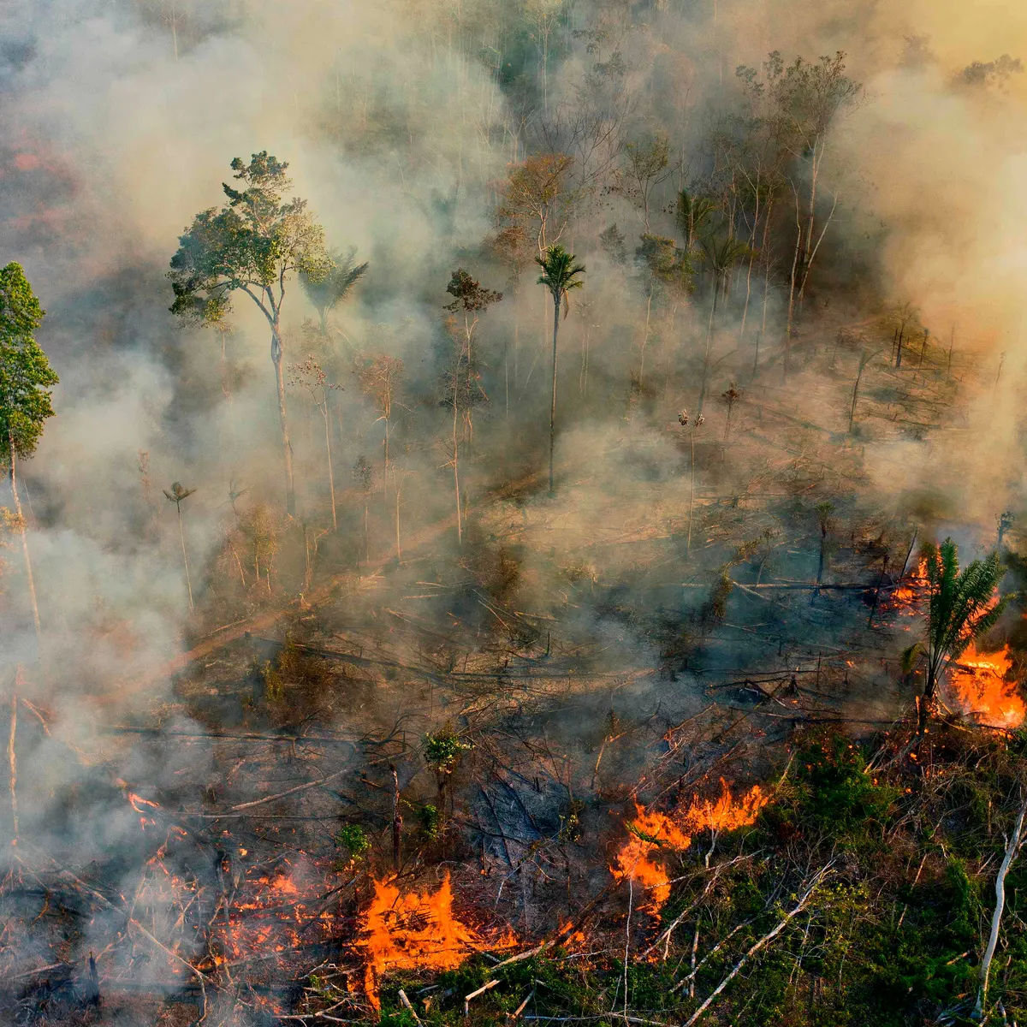
Climate Change Impacts
Health
  Weather-related mortality
  Infectious and respiratory illnesses
Agriculture
  Crop yields
  Irrigation demands
Forests (+ other ecosystems and habitats)

Slide 32
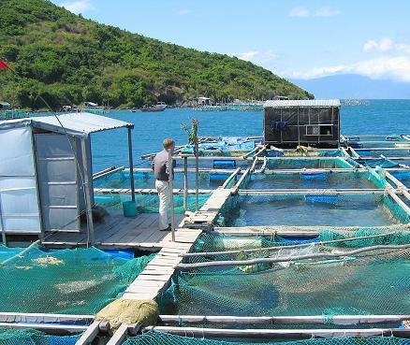
Climate Change Impacts
Health
  Weather-related mortality
  Infectious and respiratory illnesses
Agriculture
  Crop yields
  Irrigation demands
Forests (+ other ecosystems and habitats)
Water resources
  Increased competition for water
  Water quality
  Fishing

Slide 33
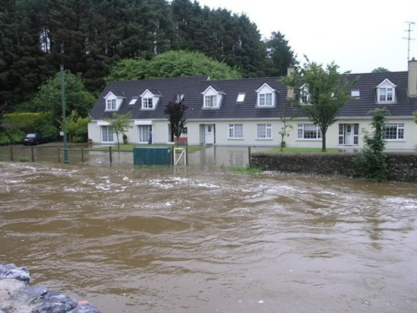
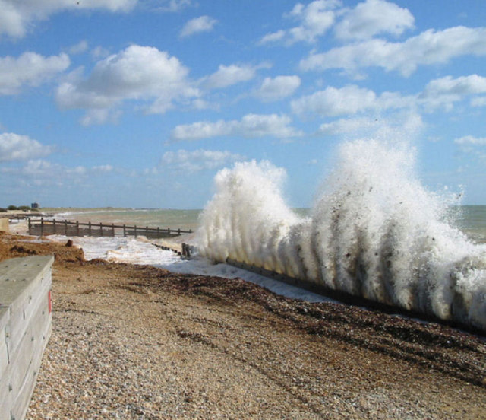
Climate Change Impacts
Health
  Weather-related mortality
  Infectious and respiratory illnesses
Agriculture
  Crop yields
  Irrigation demands
Forests (+ other ecosystems and habitats)
Water resources
  Increased competition for water
  Water quality
  Fishing
Coastal Areas
  Flood risks and increased costs for flood defences.
  Erosion of beaches

Slide 34
Discussion
Think about the climate change risks and adaptation options facing the UK:
What are the main climate change risks?
What information is required for adaptation planning?
What measures could be put in place?

Slide 35
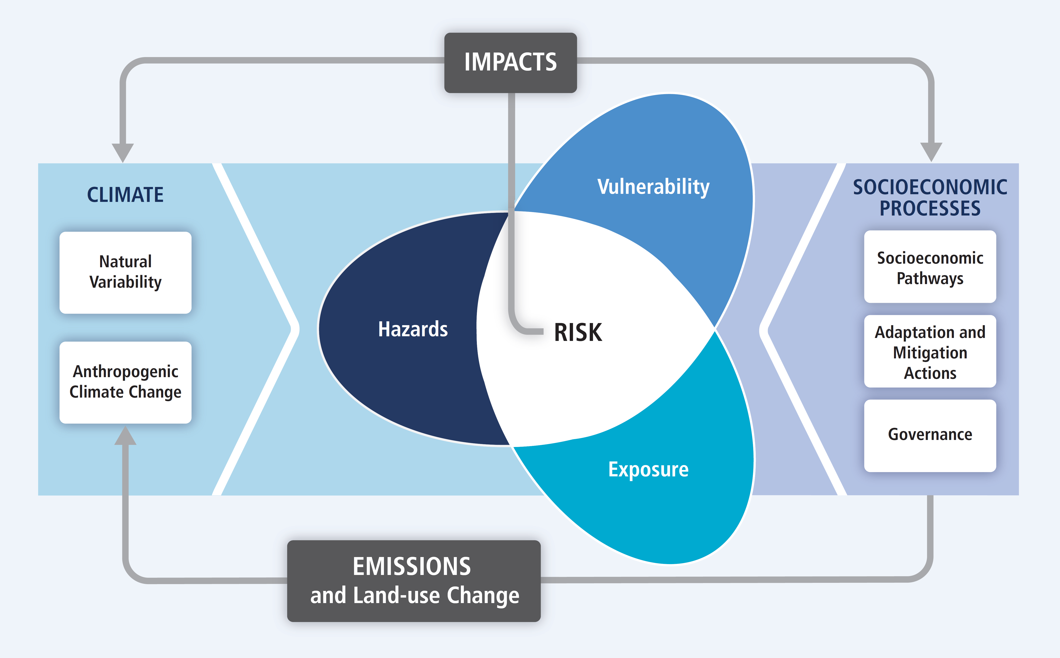
Climate Change Vulnerability
Impacts: used primarily to refer to the effects on natural and human systems of extreme weather and climate events and of climate change.
Impacts generally refer to effects on lives, livelihoods, health, ecosystems, economies, societies, cultures, services, and infrastructure due to the interaction of climate changes or hazardous climate events occurring within a specific time period and the vulnerability of an exposed society or system.
Figure TS.1, AR5 WG2 technical summary report

Slide 36
Climate Change Vulnerability
Hazards
What hazards are you exposed to? (floods, extreme rain/heat, droughts, storms, etc.)
How are these hazards changing due to climate change?
Figure TS.1, AR5 WG2 technical summary report

Slide 37
Climate Change Vulnerability
Hazards
What hazards are you exposed to? (floods, extreme rain/heat, droughts, storms, etc.)
How are these hazards changing due to climate change?
Exposure
Presence of people, infrastructure, ecosystems and other social, cultural or economic systems.
Figure TS.1, AR5 WG2 technical summary report

Slide 38
Climate Change Vulnerability
Hazards
What hazards are you exposed to? (floods, extreme rain/heat, droughts, storms, etc.)
How are these hazards changing due to climate change?
Exposure
Presence of people, infrastructure, ecosystems and other social, cultural or economic systems.
Vulnerability
Susceptibility to harm, resilience and the capacity to cope and adapt to hazards.
Figure TS.1, AR5 WG2 technical summary report

Slide 39
What can we do?
We are already committed to some level of climate change, responding to climate change involves a two-pronged approach:
Adaptation: adapting to life in a changing climate.
Mitigation: reducing climate change.
Both approaches are needed to respond to climate change!
Aim to keep temperature increases well below 2°C and pursue efforts to limit the temperature increase to 1.5°C

Slide 40
What can we do?
Adaptation: adapting to life in a changing climate.
involves adjusting to actual or expected future climate.
The goal is to reduce our risks from the harmful effects of climate change (like sea-level rise, more intense extreme weather events, or food insecurity). It also includes making the most of any potential beneficial opportunities associated with climate change (for example, longer growing seasons or increased yields in some regions).
Mitigation: reducing climate change.
involves reducing the flow of greenhouse gases into the atmosphere, either by reducing sources of these gases (for example, the burning of fossil fuels for electricity, heat, or transport) or enhancing the “sinks” that accumulate and store these gases (such as the oceans, forests, and soil).

Slide 41
What do we mean by mitigation?
From IPCC WG3 introduction.
“Climate change mitigation is achieved by limiting or preventing greenhouse gas emissions and by enhancing activities that remove these gases from the atmosphere.”
And on solar radiation management:
“SRM contrasts with climate-change mitigation activities, such as emission reductions and CO2 removal, as it introduces a ‘mask’ to the climate change problem by altering the Earth’s radiation budget, rather than attempting to address the root cause of the problem, which is the increase in greenhouse gas emissions in the atmosphere.”
WEEK 9

Slide 42
What can we do?
Adaptation: adapting to life in a changing climate.
Local solutions for local risks
Regional and local climate projections

Slide 43

Resolution of Global Climate Models
Figure SPM.7, 2.2, AR5 synthesis report

Slide 44
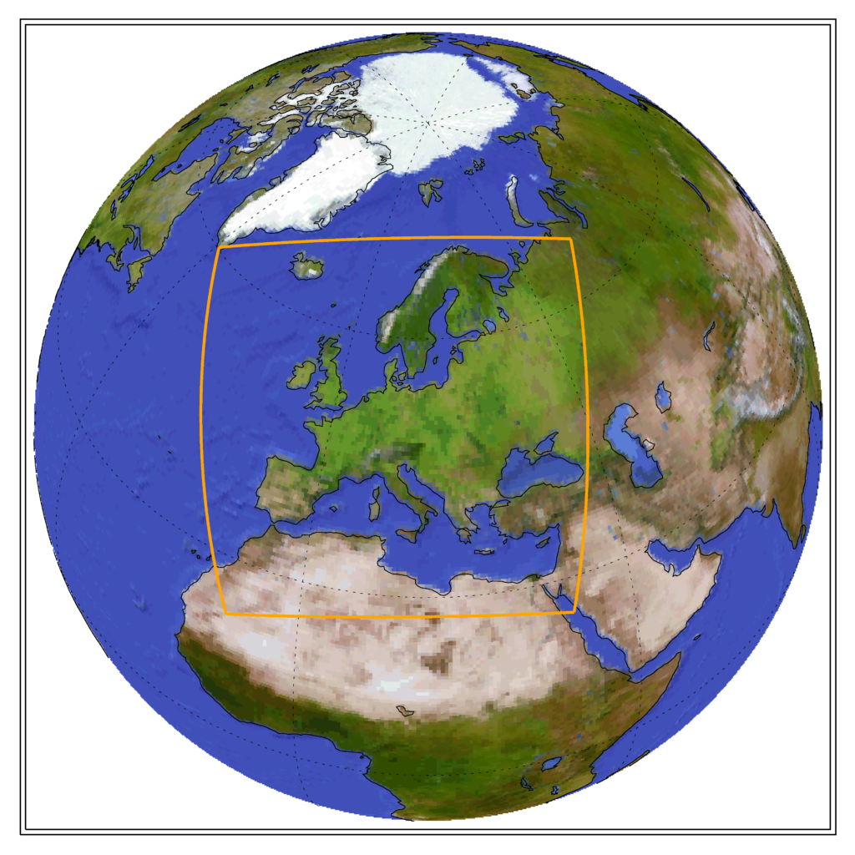
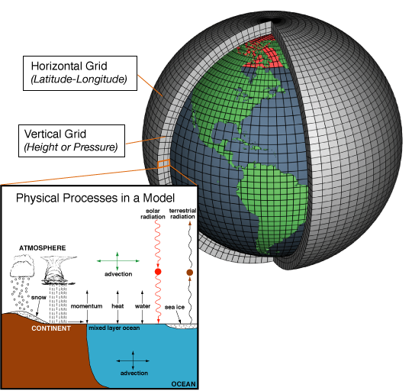
Regional Climate Models
‘Regional downscaling’
Run a climate model only over a specific region, but at a higher spatial resolution
Global Climate Models (GCM) offer future climate projections, serving as a primary driver for international decisions on climate mitigation.
Despite GCM projections, the impacts of climate change and necessary strategies will manifest at regional and national scales.
Downscaling methods address the spatial scale disparity between GCMs and the granularity required by decision-makers and impact assessors.
GCMs provide reliable predictions covering vast landscapes with diverse topographies and varying risks of extreme events.
Downscaling derives local to regional scale information from larger-scale models, enhancing the specificity and applicability of climate projections.

Slide 45
What can we do?
Adaptation: adapting to life in a changing climate.
Local solutions for local risks
Regional and local climate projections
Predictions of user-relevant quantities

Slide 46
What can we do?
Adaptation: adapting to life in a changing climate.
Local solutions for local risks
Regional and local climate projections
Predictions of user-relevant quantities
Evaluation of what risks you are exposed to

Slide 47
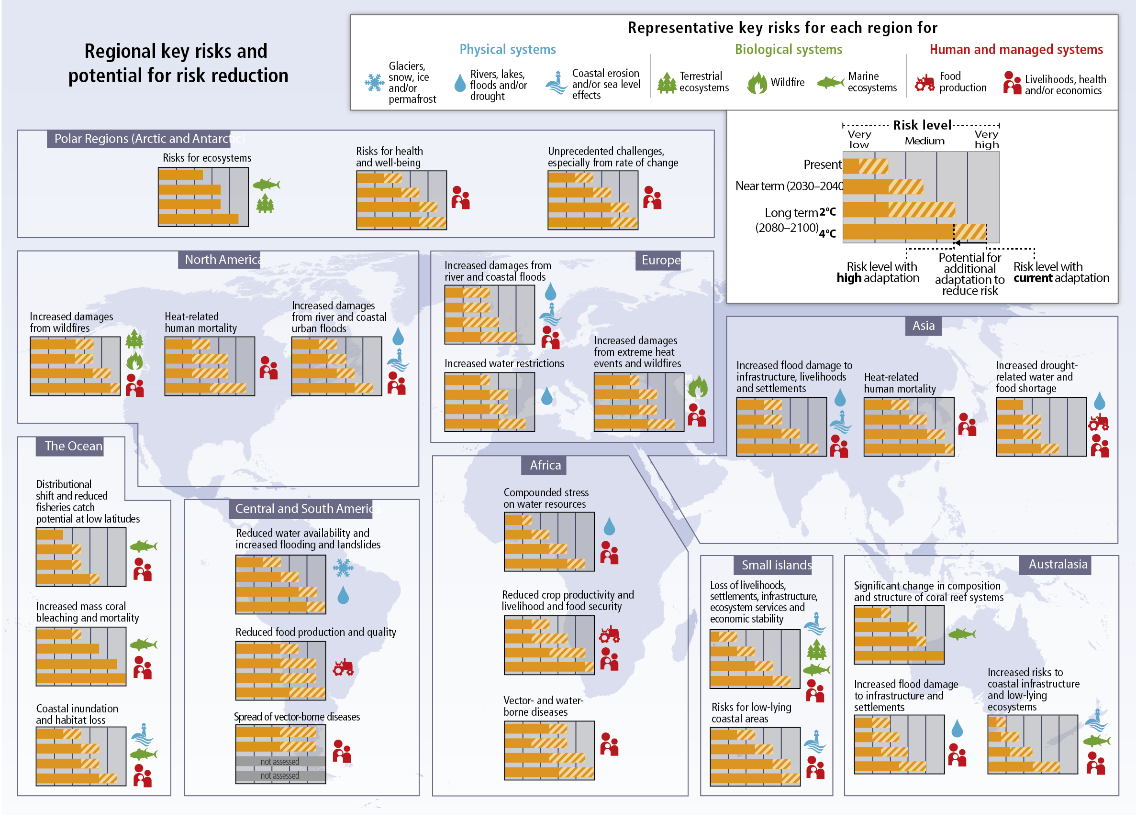
Figure SPM.8, 2.4, AR5 synthesis report

Slide 48
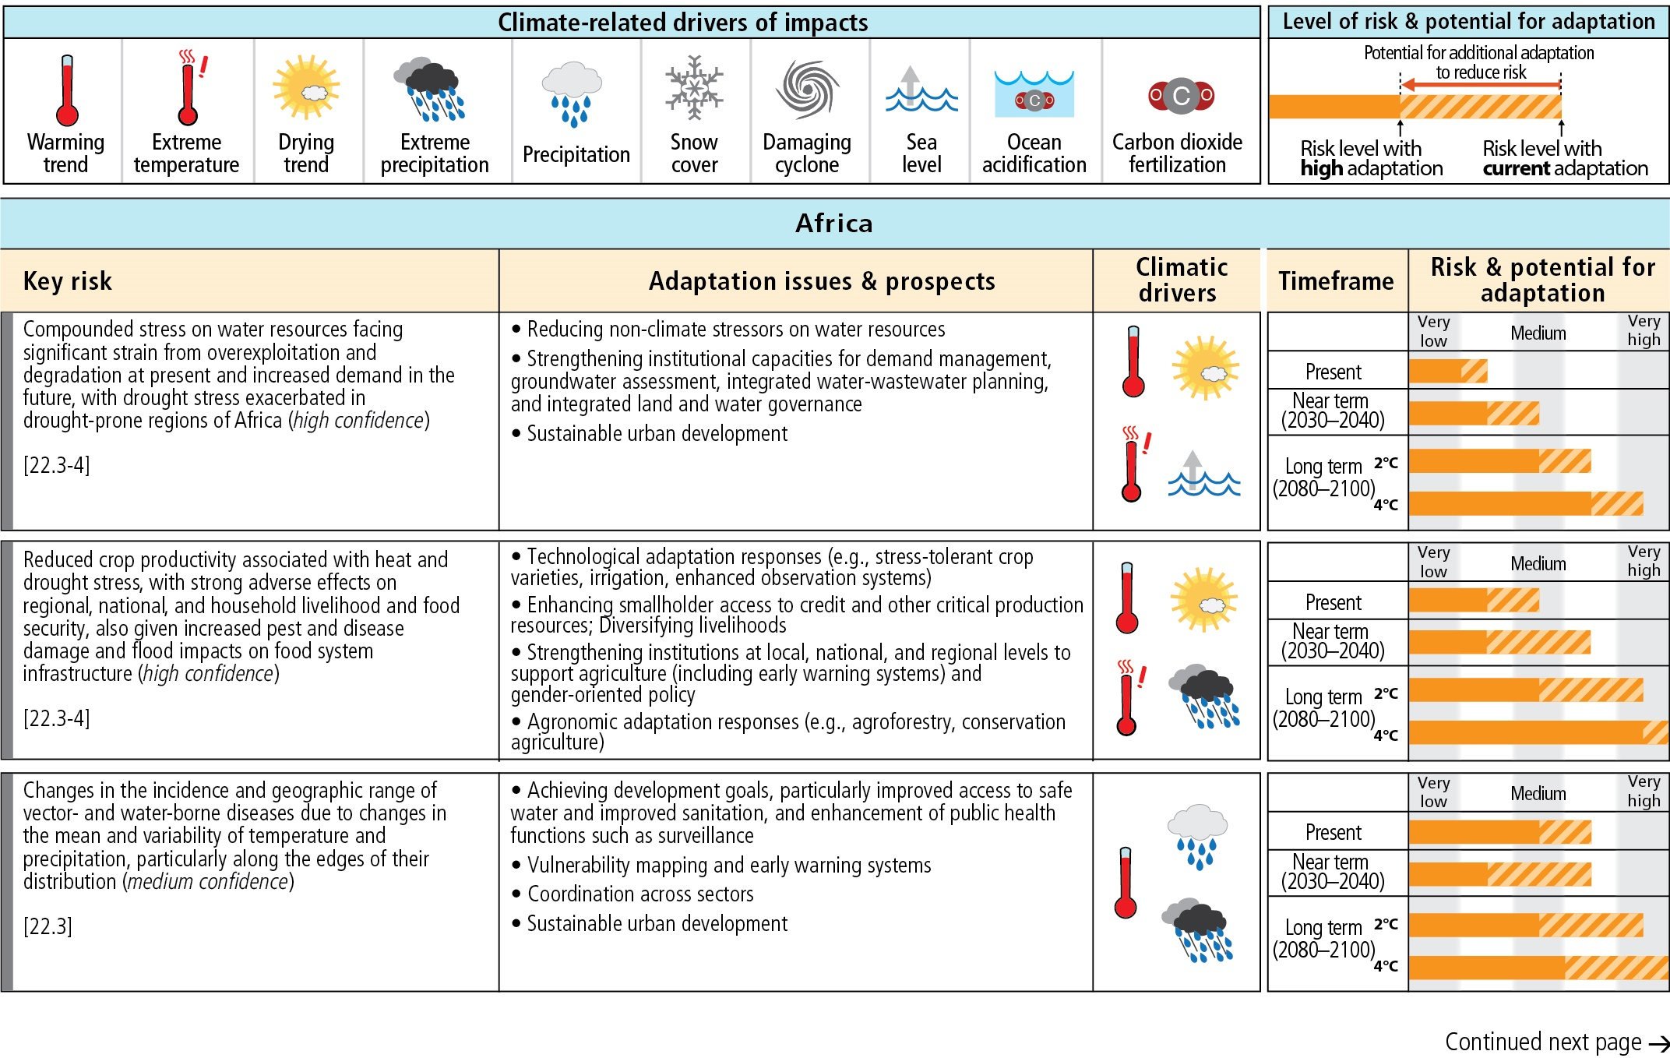

Slide 49
Assessment box SMP.2, AR5 WG2 summary for policymakers report

Slide 50
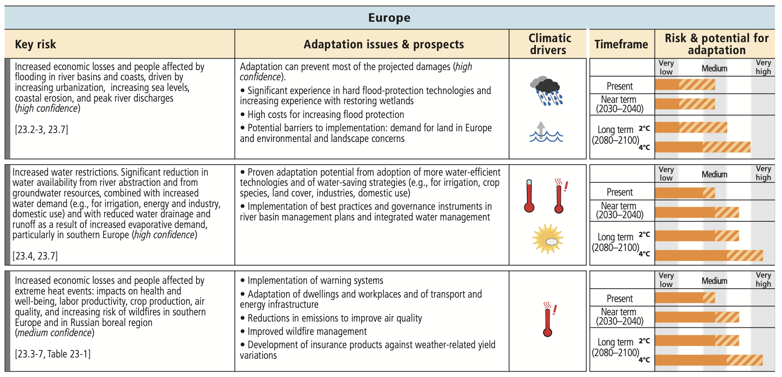
Assessment box SMP.2, AR5 WG2 summary for policymakers report

Slide 51
What can we do?
Adaptation: adapting to life in a changing climate.
Local solutions for local risks
    Regional and local climate projections.
    Predictions of user-relevant quantities.
    Evaluation of what risks you are exposed to.
But need to consider adaptation equity as those least responsible are least equipped to adapt

Slide 52
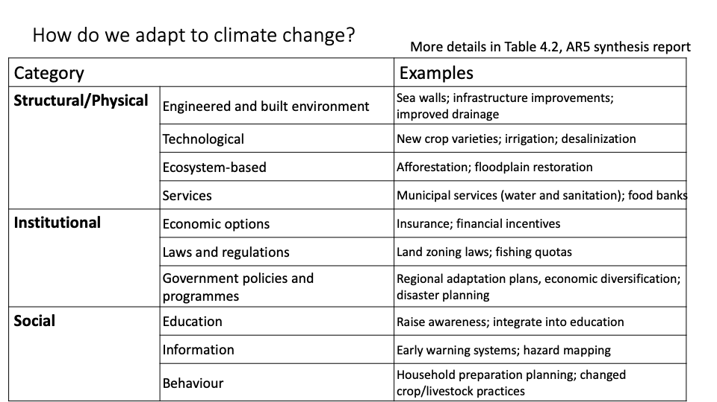
What can we do?

Slide 53
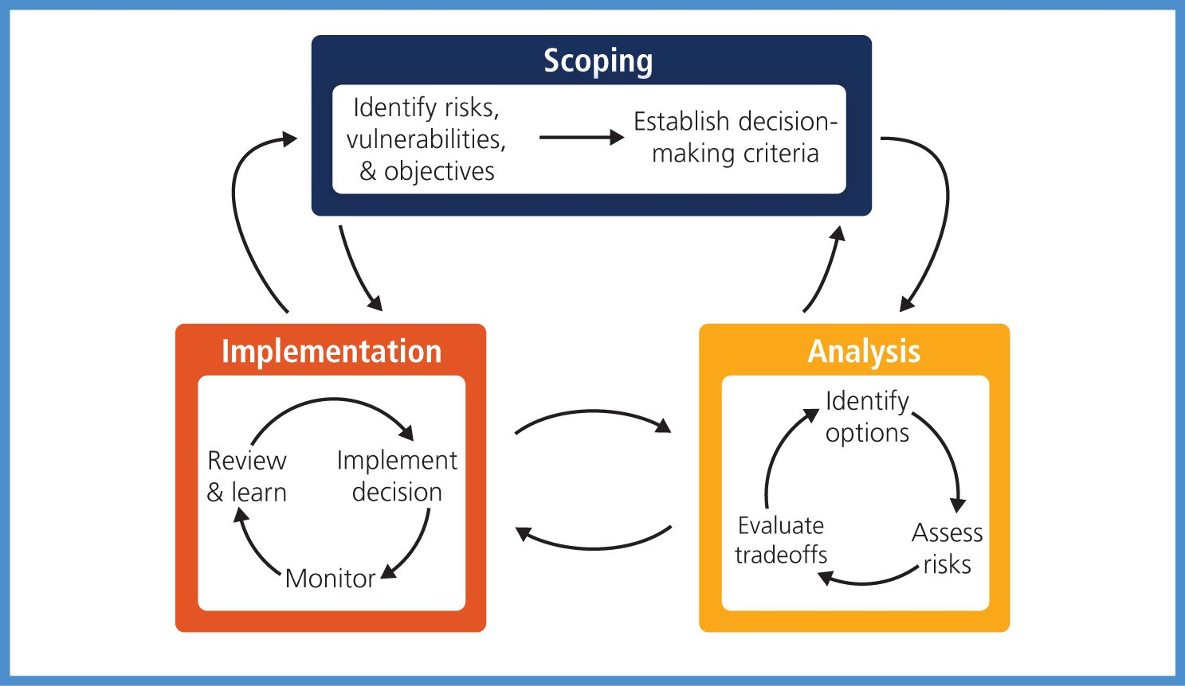
The Decision-making Context
Climate variability and extremes significant in decision-making
Responding to climate-related risks involves decision making in a changing world
Continuing uncertainty about severity and timing of climate-change impacts
Iterative risk management recommended for complex situations
Framework suitable for situations with large potential consequences and persistent uncertainties
Importance of assessing widest possible range of potential impacts highlighted
Includes low-probability outcomes with large consequences
Understanding benefits and trade-offs of alternative risk management actions essential
Monitoring and learning crucial for effective adaptation

Slide 54
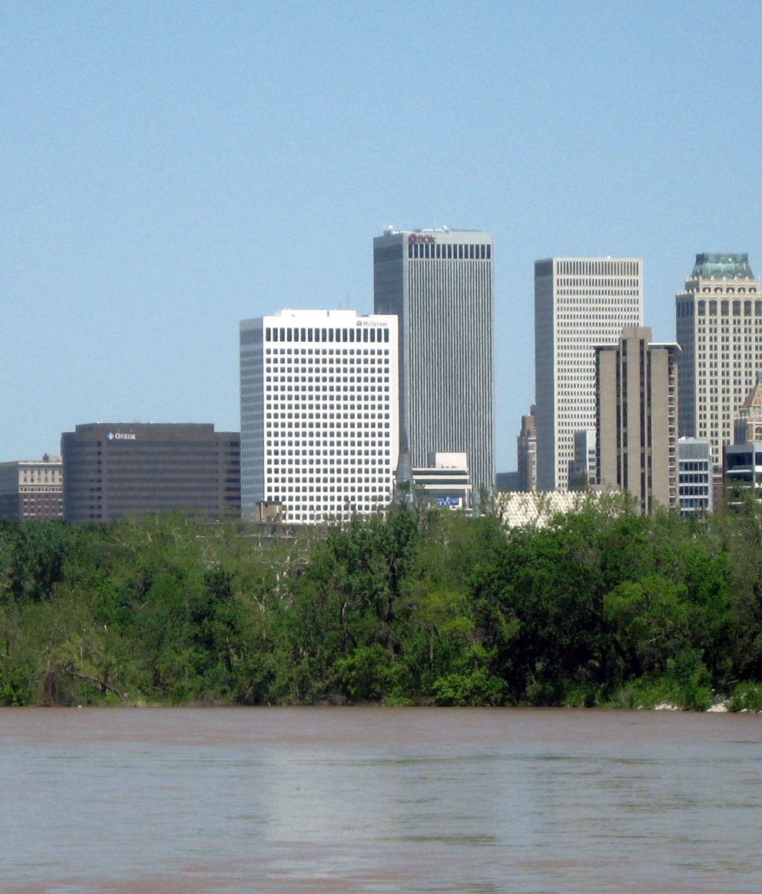
Examples where this has worked…
Tulsa, Oklahoma
In 1974, victims of a major flood in Tulsa, Oklahoma, began organising to pressure the city government to reduce flood damage.
Gradually the city improved its technical capabilities, organizational structure and funding for flood control.
After another major flood in 1984, the city banned development in floodplains and began relocating more than a thousand buildings away from them.
By 1992, Tulsa had earned the lowest flood insurance rates in the US
In 1998, Tulsa Partners began creating public-private partnerships for the mitigation of other extreme events such as droughts, ice storms and tornadoes.
Since then, the city has continued to make progress toward its long-term goal, a disaster-resistant and sustainable community.

Slide 55
Maladaptation
Maladaptation is where your adaptation approach:
Increases emissions of greenhouse gases
Disproportionately burdens the most vulnerable
Has high opportunity costs
Reduces incentives to adapt or mitigate
Sets paths that limit the choices available to future generations

Slide 56
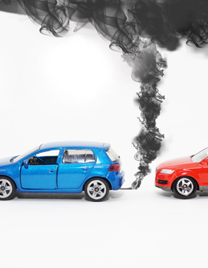
Maladaptation
In early 2012, the UK government offered incentives to motorists to encourage them to switch to diesel vehicles as part of their strategy.
The Department for Transport (DfT) acknowledges that diesel vehicles have significantly lower CO2 emissions per kilometre travelled due to their higher efficiency.
Trade-off: CO2 vs. NOx Emissions: While new generation diesel vehicles emit lower levels of carbon dioxide compared to petrol engines, they tend to emit higher levels of nitrogen oxides (NOx), particularly in urban areas.
Impact on Air Pollution: Diesel engines, especially older models, are often cited as a significant contributor to roadside air pollution in built-up urban areas, primarily due to their emissions of NOx.
Government Measures to Discourage Diesel Use: In response to environmental concerns, the government has introduced extra charges and initiatives aimed at weaning the public off diesel vehicles, reflecting a broader strategy to reduce air pollution and mitigate climate change.

Slide 57
Lecture Summary
Climate change is already driving global impacts on temperature, precipitation, sea level, ecosystems, and human health.
Impacts vary by region, with some areas experiencing more extreme heat, rainfall, or vulnerability than others.
Future climate change depends on emission pathways (RCPs) and how the climate system responds.
Higher emissions lead to more severe and widespread impacts, including extreme weather events.
Adaptation focuses on managing risks locally using projections, risk assessment, and planning.
Mitigation targets the root cause by reducing greenhouse gas emissions and enhancing carbon sinks.
Both approaches are needed together to effectively respond to current and future climate risks.

Slide 58
Example Exam Themes
Describe the difference between adaptation and mitigation
Give an example of where a positive change to mitigate against climate change could also have air quality co-benefits
Give an example of where a positive change to mitigate against climate change could also have air quality disbenefits
Give some examples of a climate change driven risk faced by the UK? How could you plan to mitigate or adapt to its impacts and why could this work effectively?
Give some examples of a climate change driven risk faced by Africa? How could you plan to mitigate or adapt to its impacts and why could this work effectively?
Describe what information you would need to plan for its impacts.
Describe a possible adaptation strategy that could reduce this risk and explain why it’s the most appropriate.
How might changes in temperature, precipitation patterns, and extreme weather events affect agricultural productivity and food availability?
Evaluate the social and economic impacts of climate change on vulnerable populations, including indigenous communities, low-income households, and developing countries.
Give an example of adaptations and mitigations to climate change

Slide 59
Week 9: Climate Change Case Studies
Agricultural practices and climate change (impacts, adaptation, mitigation)
Marine cloud brightening as a climate intervention strategy
Focus on real-world applications and implications of both approaches
Evaluation of benefits, risks, and potential unintended consequences
Links to policy, sustainability, and future climate solutions

Slide 60
Comments/Questions/Revision

Slide 61


Thank you
Thomas.Bannan@Manchester.ac.uk

Slide 62
Q1.
How does climate change impact human health? Which populations are most vulnerable?

Slide 63
Q2.
What are the key climate risks facing the UK? How should policymakers adapt?

Slide 64
Q3.
How might changes in temperature, precipitation, and extreme weather affect food availability and global agricultural productivity?

Slide 65
Q4.
How does climate change disproportionately affect vulnerable populations, such as Indigenous communities, low-income households, and developing nations?

Slide 66
Q5.
What are the key differences between RCP2.6, RCP4.5, RCP6.0, and RCP8.5? What policy choices can push us toward the lower emissions scenarios?

Slide 67
Q6.
How do increasing global temperatures contribute to extreme weather events such as hurricanes, heatwaves, and flooding? Give specific examples.

Slide 68
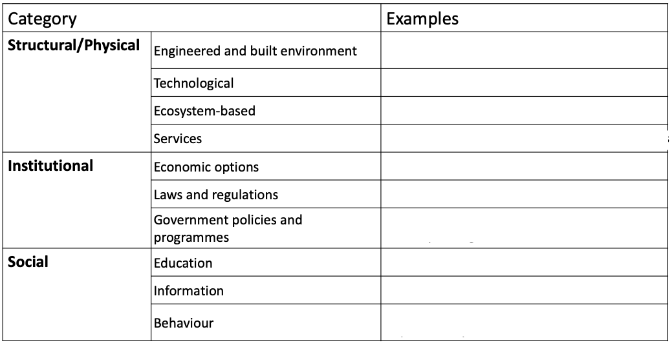
Q7.
Provide some possible examples of adaptation strategies relating to each category….

